Slide 1

Computer Vision

Slide 2

Computer Vision (CV)
Computer Vision (CV) is a branch of Artificial Intelligence (AI) that helps computers to interpret and understand visual information much like humans. This tutorial is designed for both beginners and experienced professionals and covers key concepts such as Image Processing, Feature Extraction, Object Detection, Image Segmentation and other core techniques in CV

Slide 3

R-CNN - Region-Based Convolutional Neural Networks
Traditional Convolutional Neural Networks (CNNs) with fully connected layers often struggle with object detection tasks, especially when dealing with multiple objects of varying sizes and positions within an image. A brute-force method like applying a sliding window across the image to detect objects is highly computationally expensive, as it fails to scale efficiently when object frequency and variation increase.

Slide 4
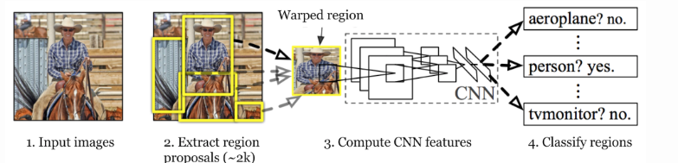
R-CNN Working

Slide 5
R-CNN Working
Input Image:
Start with a single input image containing one or more objects.
Region Proposal Generation:
Use Selective Search to generate around 2,000 region proposals (potential object locations).
Warp & Feature Extraction:
Each proposed region is cropped and resized (warped) to a fixed size. Then pass each region through a CNN to extract feature vectors.
Region Classification:
Use the extracted features to classify each region using SVMs into object categories (e.g. person, car) or background.

Slide 6
Fast R-CNN
The approach is similar to the R-CNN algorithm. But, instead of feeding the region proposals to the CNN, we feed the input image to the CNN to generate a convolutional feature map. From the convolutional feature map, we identify the region of proposals and warp them into squares and by using a RoI pooling layer we reshape them into a fixed size so that it can be fed into a fully connected layer. From the RoI feature vector, we use a softmax layer to predict the class of the proposed region and also the offset values for the bounding box.
The reason “Fast R-CNN” is faster than R-CNN is because you don’t have to feed 2000 region proposals to the convolutional neural network every time. Instead, the convolution operation is done only once per image and a feature map is generated from it.

Slide 7
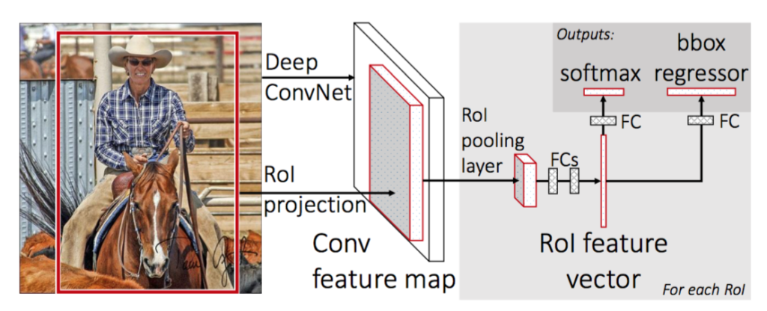
Fast R-CNN architecture

Slide 8
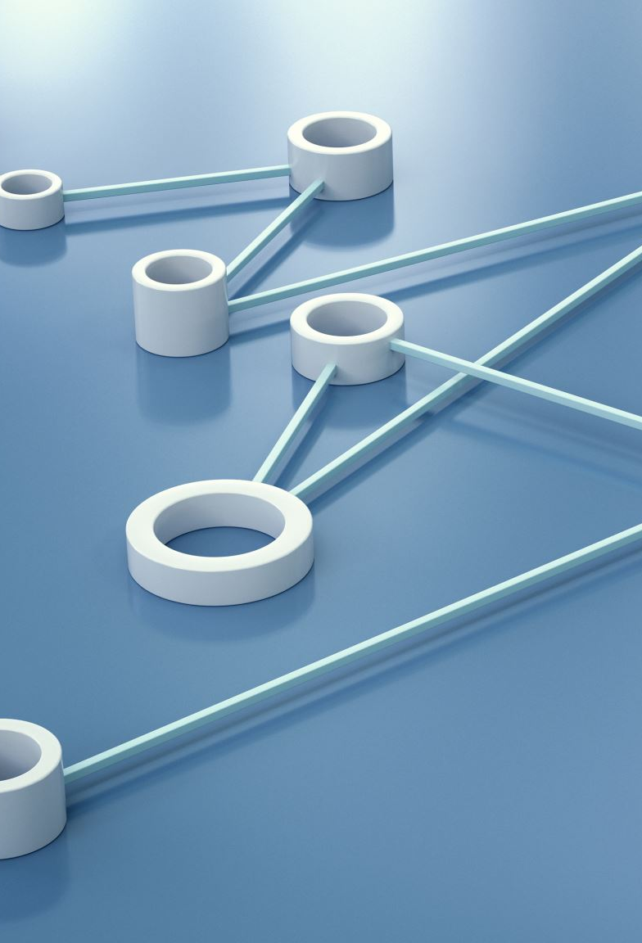
Faster R-CNN
Faster R-CNN is a popular deep learning model used for object detection which involves identifying and localizing objects within an image. Building on earlier models like R-CNN and Fast R-CNN, Faster R-CNN introduced a significant improvement by incorporating a Region Proposal Network (RPN) that generates object proposals directly within the model. This integration makes it faster and more accurate allowing it to detect multiple objects in real time with high precision.

Slide 9
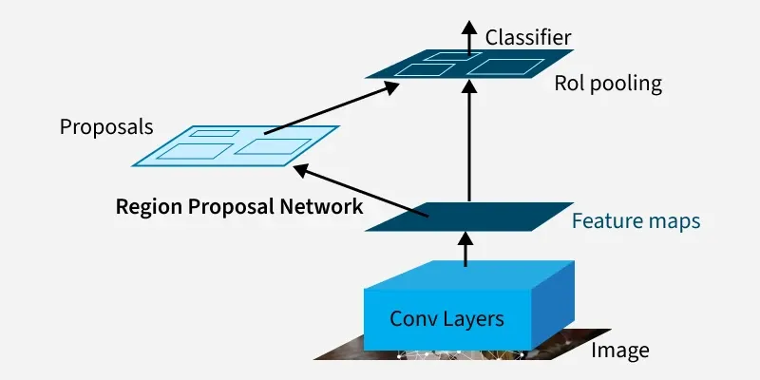
Faster R-CNN

Slide 10
Architecture of Faster R-CNN
Backbone Network
Region Proposal Network (RPN)
Region of Interest(RoI) Pooling
Detection Network

Slide 11
Backbone Network
The backbone is usually a deep CNN like VGG16, ResNet or ResNeXt.
It extracts feature maps from the input image.
These feature maps are shared by both the RPN and the detection network.

Slide 12
Region Proposal Network (RPN)
1. RPN is a small network sliding over the feature map.
2. It predicts:
Objectness score: Probability that a region contains an object.
Bounding box coordinates: Refinement of proposed regions.
3. Uses anchors (predefined boxes of different scales and aspect ratios) to propose regions efficiently.
4. End-to-end training allows RPN and the detection network to share features.

Slide 13
Region of Interest(RoI) Pooling
Converts the proposed regions of varying sizes into a fixed-size feature map for the detection network.
Ensures uniform input size for fully connected layers.
Detection Network
Classifies each proposed region into object categories.
Refines bounding boxes for precise localization.
Uses softmax for classification and smooth L1 loss for bounding box regression.

Slide 14
Evolution of R-CNN Models
R-CNN (2013)
Used CNN to classify around 2,000 region proposals generated by Selective Search.
Processed each region separately, causing slow inference.
Used SVM for classification.
Fast R-CNN (2015)
Ran CNN once over the full image to produce shared feature maps.
Used ROI(Region of Interest) Pooling to extract fixed-size features from proposed regions.
Replaced SVM with neural network classifier.
Still depended on slow Selective Search for proposals.
Faster R-CNN (2015)
Introduced Region Proposal Network (RPN) integrated with CNN for fast proposal generation.
Enabled end-to-end training of both region proposal and detection.
Greatly improved speed and accuracy.

Slide 15
YOLO : You Only Look Once
YOLO was proposed by Joseph Redmond et al. in 2015 to deal with the problems faced by the object recognition models at that time, Fast R-CNN was one of the models at that time but it had its own challenges such as that network could not be used in real-time because it took 2-3 seconds to predict an image and therefore could not be used in real-time. Whereas in YOLO we have to look only once in the network i.e. only one forward pass is required through the network to make the final predictions.

Slide 16
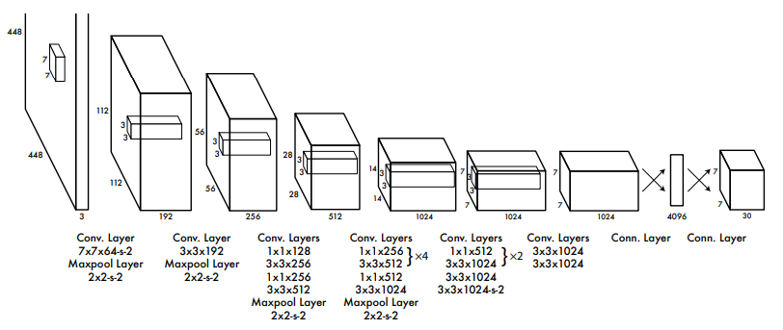
YOLO Architecture

Slide 17
YOLO Architecture
1. Input Preprocessing:
The model accepts an image as input. It resizes the input image to 448×448 pixels ensuring that the aspect ratio is preserved using padding. This ensures uniformity of input dimensions across the network which is essential for batch processing in deep learning.
2. Backbone Convolutional Neural Network (CNN):
After preprocessing the image is passed through a deep CNN architecture designed for object detection:
The model consists of 24 convolutional layers and 4 max-pooling layers.
These layers help in extracting hierarchical spatial features from the image.

Slide 18
YOLO Architecture
3. Use of 1×1 and 3×3 Convolutions:
To reduce the number of parameters and compress channels, 1×1 convolutions are employed.
These are followed by 3×3 convolutions to capture spatial patterns in the feature maps.
This design pattern i.e 1×1 followed by 3×3 improves computational efficiency while maintaining expressive power.
4. Fully Connected Layers:
Following the convolutional layers, the architecture has 2 fully connected layers. The final fully connected layer produces an output of shape (1, 1470).

Slide 19
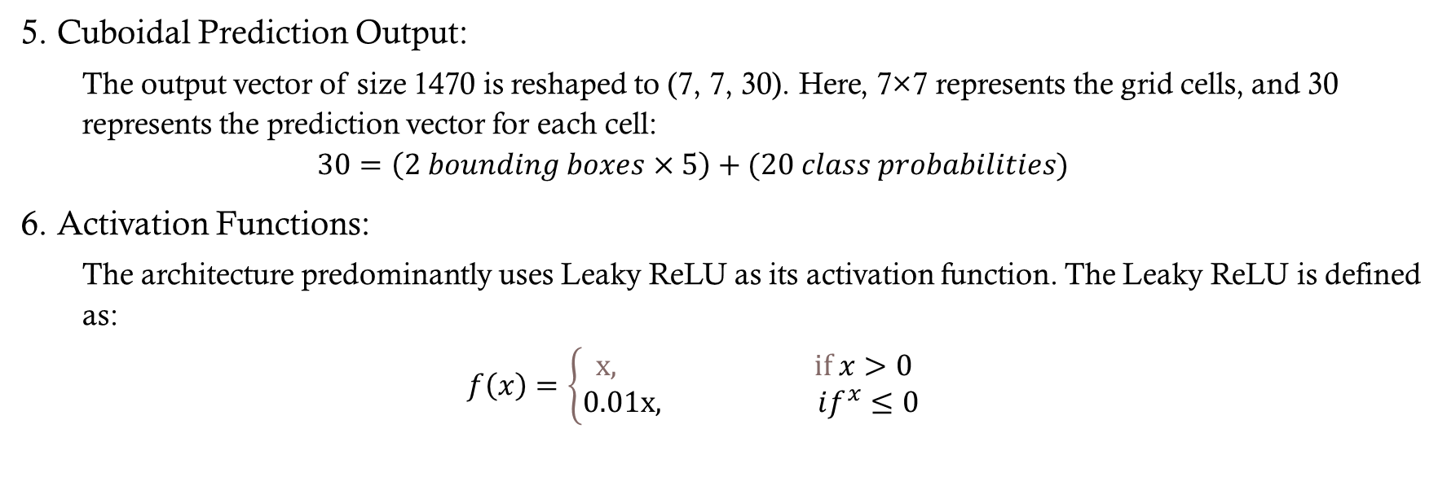
YOLO Architecture
5. Cuboidal Prediction Output:
The output vector of size 1470 is reshaped to (7, 7, 30). Here, 7×7 represents the grid cells, and 30 represents the prediction vector for each cell:
$$30=\left(2 bounding boxes×5\right)+(20 class probabilities)$$
6. Activation Functions:
The architecture predominantly uses Leaky ReLU as its activation function. The Leaky ReLU is defined as:
$$f\left(x\right)=\left\{\begin{matrix} x, if x>0 \\ 0.01x, if^{x}≤0\end{matrix}\right.$$

Slide 20
YOLO Architecture
7. Output Layer Activation:
The last layer uses a linear activation function, suitable for making raw predictions like bounding box coordinates and confidence scores.
8. Regularization Techniques:
Batch Normalization is employed across layers to stabilize and accelerate training.
Dropout is also incorporated to prevent overfitting by randomly deactivating neurons during training, encouraging the network to learn more robust features.

Slide 21
YOLO Applications
Healthcare
Agriculture
Security surveillance
Self-driving cars

